Slide 1

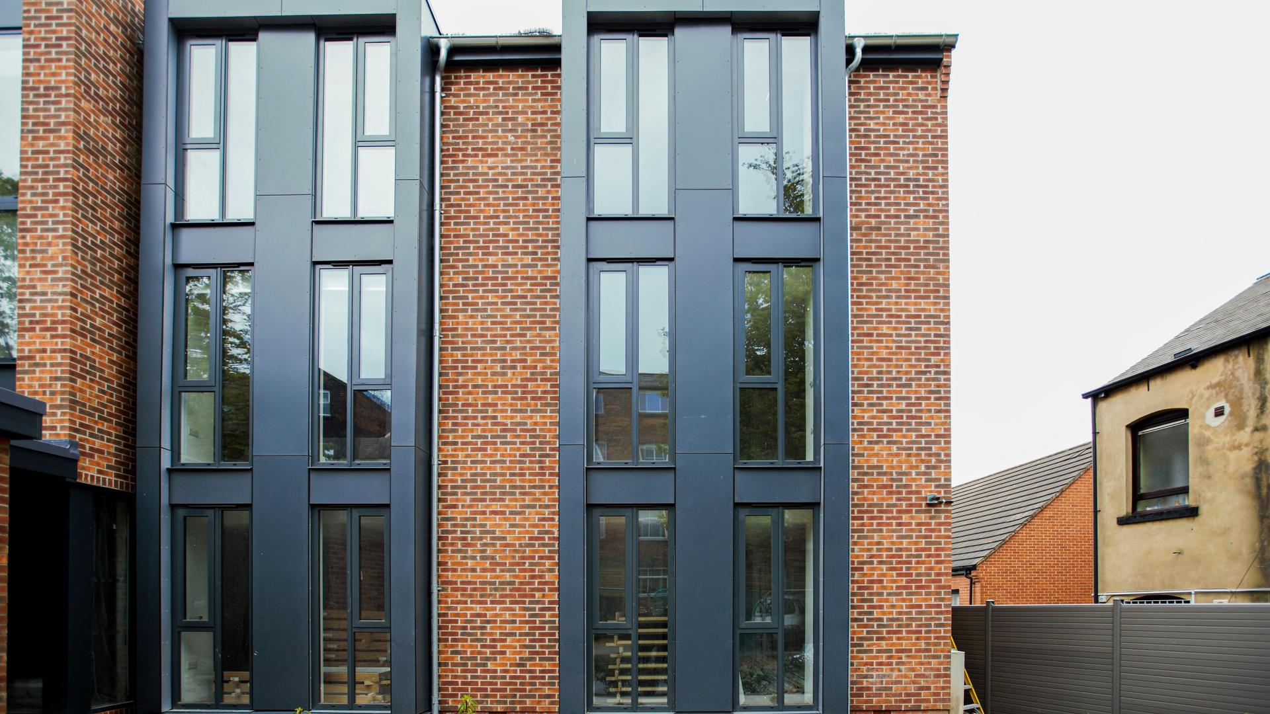
INSTITUTIONAL STUDENT HOUSING INVESTMENT OPPORTUNITY
WAISHE
STUDENT HOUSING
Purpose-Built Student Accommodation Development
2400
R624M
BED PBSA DEVELOPMENT
TOTAL INVESTMENT
LOCATION
PREPARED BY
Thohoyandou, Limpopo, South Africa
Glen Mapholi & Associates Inc.

Slide 2
INSTITUTIONAL STUDENT HOUSING INVESTMENT OPPORTUNITY
WAISHE
STUDENT HOUSING
Purpose-Built Student Accommodation Development
2,400
800
R208M
BED PBSA DEVELOPMENT
PHASE 1 BEDS
PHASE 1 INVESTMENT
LOCATION
PREPARED BY
Thohoyandou, Limpopo, South Africa
TF Maiwashe & Associates Inc.

Slide 3
EXECUTIVE SUMMARY
Investment Opportunity at a Glance
↗
Significant Market Gap
▿
Anchor Demand
Over 8,000 student beds in short supply
University of Venda student population exceeding 16,700
✦
Phased Development Strategy
$
Attractive Returns
Phase 1: 800 beds | Full Development: 2,400 beds
Target IRR: 18%–22% · Yield on Cost: 12%–13%
NSFAS-aligned revenue framework
CAPITAL REQUIREMENT
Phase | Beds | Investment
Phase 1 | 800 | R208M
Full Development | 2,400 | R624M

Slide 4
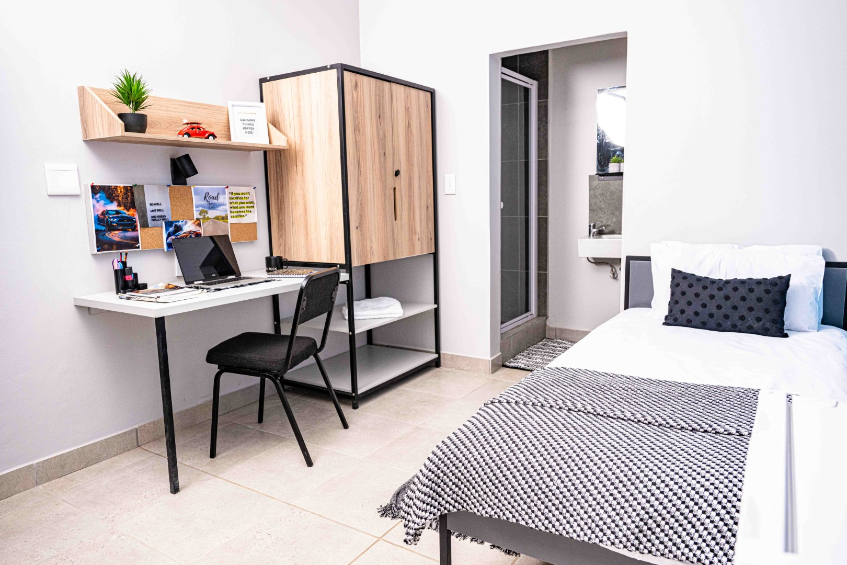
MARKET OPPORTUNITY
Structural Supply Deficit
UNIVERSITY OF VENDA MARKET
Student Population | 16,700+
Formal Accommodation Supply | Limited
Informal Accommodation Supply | Fragmented
Estimated Shortfall | 8,000+ Beds
MARKET CHARACTERISTICS
arrow_right Growing student enrolment
arrow_right Persistent accommodation shortage
arrow_right Predominantly informal providers
arrow_right Limited institutional-quality stock
arrow_right Strong demand fundamentals
"Demand significantly exceeds quality accommodation supply."

Slide 5

STRATEGIC POSITIONING
First-Mover Institutional Advantage
⚠
Current Market
✓
Waishe Student Housing
✗ Small-scale landlords
✗ Inconsistent standards
✗ Limited amenities
✗ Operational inefficiencies
✓ Institutional-scale development
✓ Professional management
✓ Purpose-built design
✓ Modern amenities
✓ NSFAS-ready operations
COMPETITIVE EDGE
★
Scale advantage
◆
Quality differentiation
⚙
Operational excellence
♛
Long-term brand value

Slide 6
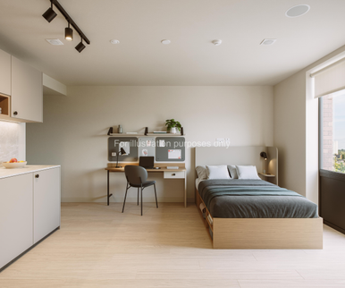
PROJECT OVERVIEW
Development Concept
TOTAL STUDENT BEDS
PHASE 1
2,400
800
Full development capacity across all phases
Beds — Initial deployment
✦
Bachelor Units
One-Bedroom Apartments
Shared Three-Bedroom
✦
✦
Independent living
Higher rental yield
Balanced affordability
Strong demand
Cost-efficient
Core volume
▥
Community Features
▤
Study areas
◌
High-speed Wi-Fi
⛨
Secure access control
❄
Laundry facilities
🏪
Retail convenience
✦
Recreational spaces

Slide 7
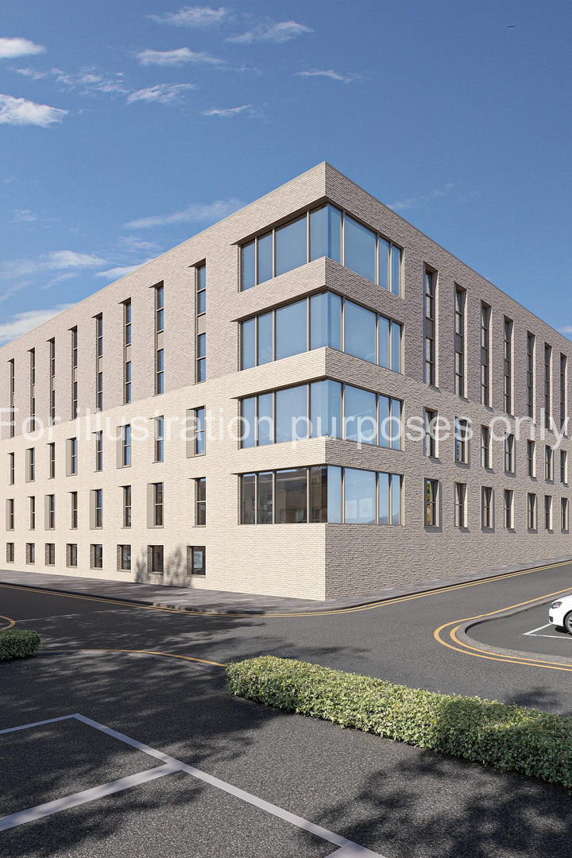
FINANCIAL HIGHLIGHTS
Phase 1 Financial Metrics
🏛
↗
$
◐
✦
R208M
R46.2M
R27.7M
90%
R5,000
TOTAL DEVELOPMENT COST
STABILISED REVENUE
NOI
OCCUPANCY TARGET
AVG RENT / BED / MONTH
▦
Performance Indicators
NOI MARGIN
DEBT SERVICE COVERAGE RATIO
CASH FLOW PROFILE
Strong institutional benchmark
1.25x
Stable recurring cash flows

Slide 8
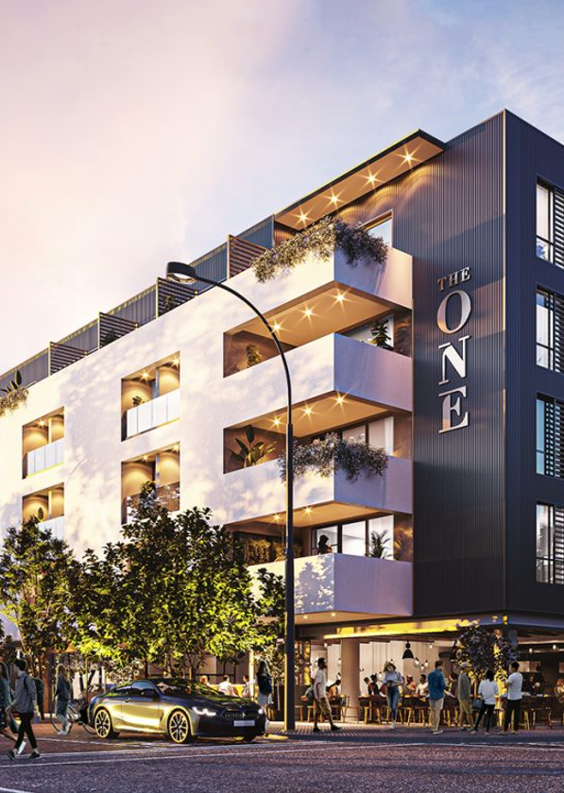
CAPITAL STRUCTURE
Funding Framework
TOTAL CAPITAL REQUIREMENT
R208M
✦
Capital Stack
Senior Debt
70% — R145.6M
R145.6M
Equity
30% — R62.4M
R62.4M
⌇
Investor Returns
Metric | Target
IRR | 18%–22%
Yield on Cost | 12%–13%
Preferred Return | 12%–15%
INVESTMENT CHARACTERISTICS
✓
Long-term inflation-linked income
✓
Real asset backing
✓
Strong demand fundamentals

Slide 9
DEVELOPMENT STRATEGY
Controlled Growth Model
PHASE 1
PHASE 2
800
Beds
1,600
Additional Beds
R208M Investment
→
R416M Investment
OBJECTIVES
OBJECTIVES
arrow_rightMarket validation
arrow_rightOperational optimisation
arrow_rightOccupancy stabilisation
arrow_rightScale platform
arrow_rightIncrease asset value
arrow_rightEnhance financing flexibility
◆
Lower execution risk through phased capital deployment.
PRODUCT OFFERING
✦
Premium Bachelor Units
✦
One-Bedroom Apartments
✦
Shared Apartments
Independent living, higher yield
Balanced affordability, strong demand
Cost-efficient, core volume
AMENITIES
◌
Campus-grade Wi-Fi
⛨
24-Hour Security
▤
Study Facilities
▣
Gym
❄
Laundry
🏪
Retail

Slide 10
REVENUE SECURITY
Predictable Income Platform
↗
Demand Drivers
⛨
Revenue Protection
＋
Additional Revenue Streams
›
University enrolment growth
›
Significant accommodation shortage
›
Strategic project location
NSFAS-ALIGNED MODEL
›
Parking
›
Laundry
›
Retail leasing
›
Value-added services
›
Government-supported funding framework
›
Structured payment process
›
Improved collection efficiency
ESG & SOCIAL IMPACT
Investing in Educational Infrastructure
▿
Social Impact
▭
Economic Impact
✿
ESG Alignment
›
2,400 formal student beds
›
Improved living conditions
›
Enhanced educational outcomes
›
Community development
›
Construction: 250–400 jobs
›
Operational: 40–80 permanent jobs
›
Social infrastructure investment
›
Community upliftment
›
Sustainable development outcomes

Slide 11
RISK MANAGEMENT
Key Risk Mitigation Measures
⚒
Development Risk
◔
Transaction Timeline
Design-build procurement model · Professional project management
PATH TO FINANCIAL CLOSE
◫
Cost Risk
Quantity surveyor oversight · Budget certification
1
Term Sheet Execution
Months 0–2
♟
Occupancy Risk
2
Due Diligence
Proven demand shortage · University proximity
Months 2–6
3
Credit Approval
Operational Risk
Months 5–10
⚙
Professional management platform
4
Financial Close
Months 8–16
⛨
Financial Risk
Phased implementation strategy
⚑
MILESTONE
Investment Close & Construction Commencement

Slide 12
EXIT STRATEGY
Multiple Liquidity Pathways
01
02
03
04
Refinance
Institutional Sale
Portfolio Aggregation
Strategic PBSA Sale
›
Stabilised NOI
›
Improved debt terms
›
Equity recapitalisation
›
REIT acquisition
›
Infrastructure funds
›
Pension funds
›
Multi-campus platform
›
Enhanced valuation multiple
›
Specialist housing investors
›
International operators
INVESTMENT THESIS
Why Invest in Waishe Student Housing?
⌇
Demand-Backed
⛨
Risk-Managed
▥
Institutional Quality
8,000+ bed shortage creates structural demand
Phased development reduces execution exposure
Professional operations and governance
$
Attractive Returns
＋
Scalable Platform
♥
Social Impact
18%–22% target IRR
Foundation for future PBSA expansion
Supporting education through quality housing

Slide 13
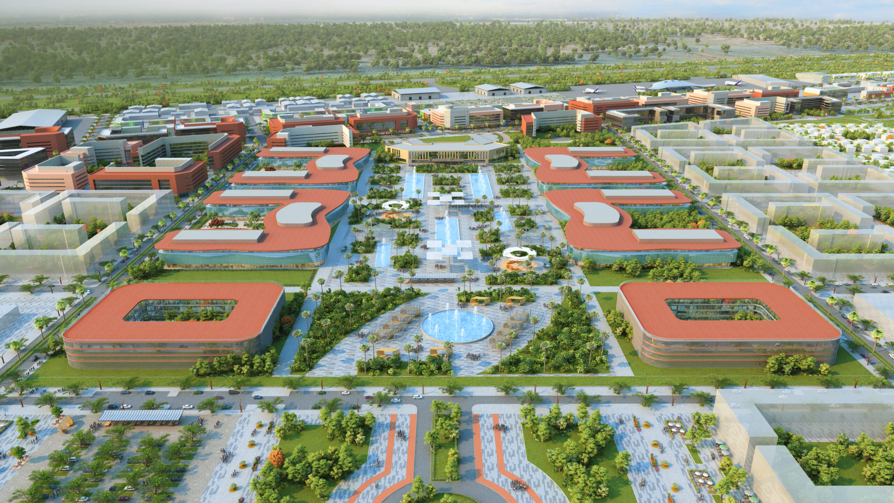

Partner With Us
PHASE 1 EQUITY REQUIREMENT
R62.4 MILLION
▥
Contact
TF Maiwashe & Associates Inc
♟
Investor Profile
Glen Mapholi
DEVELOPMENT FINANCE INSTITUTIONS
PRIVATE EQUITY FUNDS
☎
+27 79 259 7711
INFRASTRUCTURE INVESTORS
INSTITUTIONAL CAPITAL PARTNERS
✉
glen@pfukogroup.co.za
◎
Project Location
→
Next Steps
Thohoyandou, Limpopo
South Africa
1.
Execute NDA
2.
Access Data Room
3.
Due Diligence Review
4.
Investment Discussions
Delivering Quality Student Housing. Creating Sustainable Returns.

